Slide 1
Chapter 7
Managing Risk

Slide 2
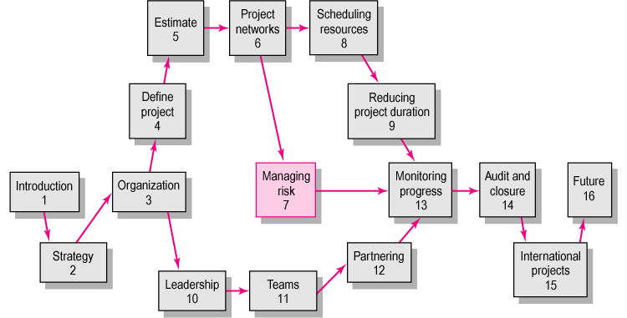
Copyright © 2006 The McGraw-Hill Companies. All rights reserved.
McGraw-Hill/Irwin 7–<number>

Slide 3
Risk Management Process
Risk
  Uncertain or chance events that planning can not overcome or control.
Risk Management
  A proactive attempt to recognize and manage internal events and external threats that affect the likelihood of a project’s success.
    What can go wrong (risk event).
    How to minimize the risk event’s impact (consequences).
    What can be done before an event occurs (anticipation).
    What to do when an event occurs (contingency plans).
Copyright © 2006 The McGraw-Hill Companies. All rights reserved.
McGraw-Hill/Irwin 7–<number>

Slide 4
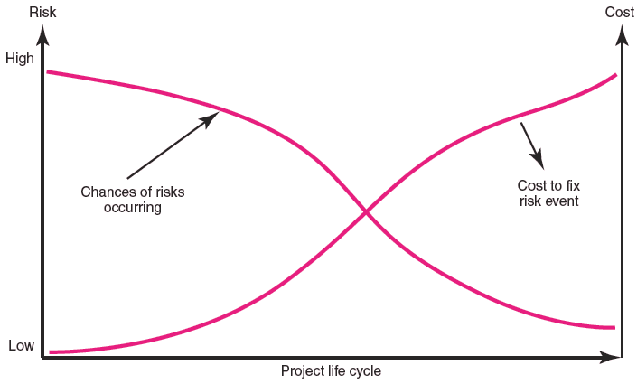
The Risk Event Graph
FIGURE 7.1
Copyright © 2006 The McGraw-Hill Companies. All rights reserved.
McGraw-Hill/Irwin 7–<number>

Slide 5
Risk Management’s Benefits
A proactive rather than reactive approach.
Reduces surprises and negative consequences.
Prepares the project manager to take advantage of appropriate risks.
Provides better control over the future.
Improves chances of reaching project performance objectives within budget and on time.
Copyright © 2006 The McGraw-Hill Companies. All rights reserved.
McGraw-Hill/Irwin 7–<number>
Notes:
These are some reasons why we must manage risks in a project
1. Predict something and take actions before it really happens is better than react after having consequences
2&3. Knowing risks CAN: reduce/eliminate negative effects OR take some chances to optimize results of the project
4. Give us a prospect of what might happen later on in your project → take control over those elements
5. Since we know where risks might happen, we can develop some suitable response and therefore,….

Slide 6
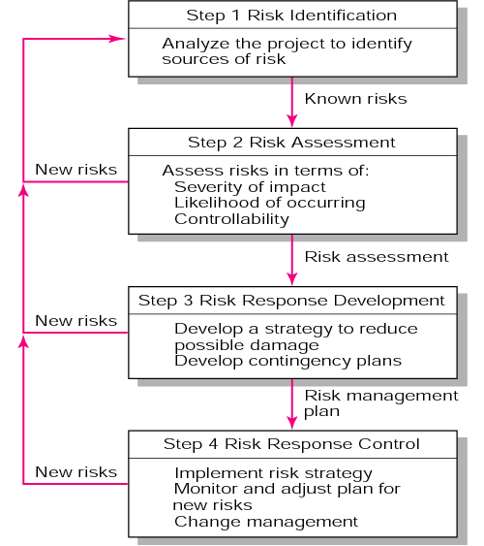
The Risk Management Process
FIGURE 7.2
Copyright © 2006 The McGraw-Hill Companies. All rights reserved.
McGraw-Hill/Irwin 7–<number>

Slide 7
Managing Risk
Step 1: Risk Identification
  Generate a list of possible risks through brainstorming, problem identification and risk profiling.
    Macro risks first, then specific events
Step 2: Risk assessment
  Scenario analysis
  Risk assessment matrix
  Failure Mode and Effects Analysis (FMEA)
  Probability analysis
    Decision trees, NPV, and PERT
  Semiquantitative scenario analysis
Copyright © 2006 The McGraw-Hill Companies. All rights reserved.
McGraw-Hill/Irwin 7–<number>

Slide 8
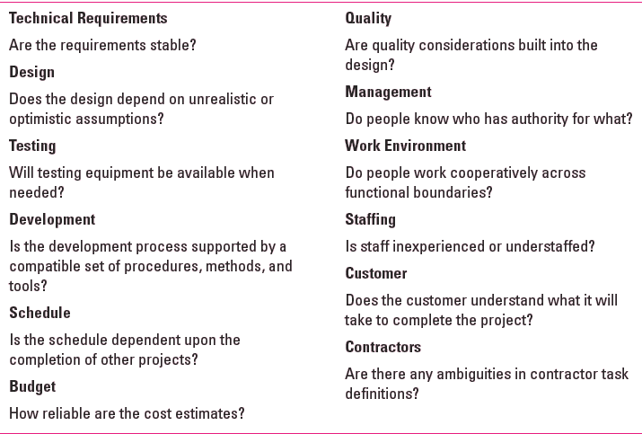
Partial Risk Profile for
Product Development Project
FIGURE 7.3
Copyright © 2006 The McGraw-Hill Companies. All rights reserved.
McGraw-Hill/Irwin 7–<number>

Slide 9
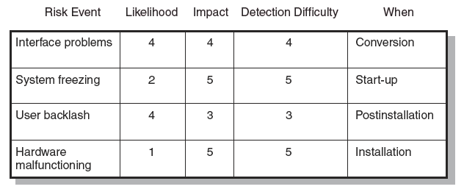
Risk Assessment Form
FIGURE 7.4
Copyright © 2006 The McGraw-Hill Companies. All rights reserved.
McGraw-Hill/Irwin 7–<number>

Slide 10
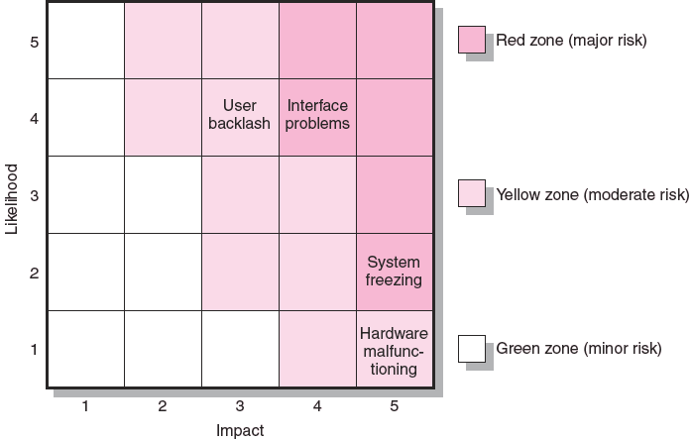
Risk Severity Matrix
FIGURE 7.5
Copyright © 2006 The McGraw-Hill Companies. All rights reserved.
McGraw-Hill/Irwin 7–<number>

Slide 11
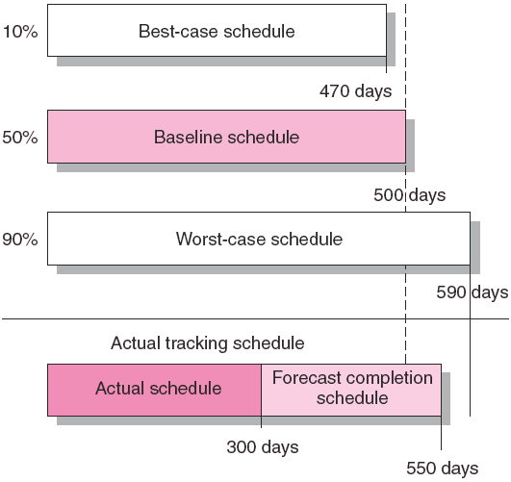
Risk Schedules
FIGURE 7.6
Copyright © 2006 The McGraw-Hill Companies. All rights reserved.
McGraw-Hill/Irwin 7–<number>

Slide 12
Managing Risk (cont’d)
Step 3: Risk Response Development
  Mitigating Risk
    Reducing the likelihood an adverse event will occur.
    Reducing impact of adverse event.
  Transferring Risk
    Paying a premium to pass the risk to another party.
  Avoiding Risk
    Changing the project plan to eliminate the risk or condition.
  Sharing Risk
    Allocating risk to different parties
  Retaining Risk
    Making a conscious decision to accept the risk.
Copyright © 2006 The McGraw-Hill Companies. All rights reserved.
McGraw-Hill/Irwin 7–<number>

Slide 13
Contingency Planning
Contingency Plan
  An alternative plan that will be used if a possible foreseen risk event actually occurs.
  A plan of actions that will reduce or mitigate the negative impact (consequences) of a risk event.
Risks of Not Having a Contingency Plan
  Having no plan may slow managerial response.
  Decisions made under pressure can be potentially dangerous and costly.
Copyright © 2006 The McGraw-Hill Companies. All rights reserved.
McGraw-Hill/Irwin 7–<number>

Slide 14
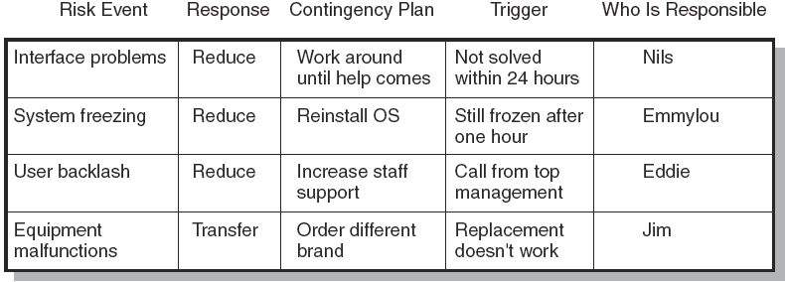
Risk Response Matrix
FIGURE 7.7
Copyright © 2006 The McGraw-Hill Companies. All rights reserved.
McGraw-Hill/Irwin 7–<number>

Slide 15
Risk and Contingency Planning
Technical Risks
  Backup strategies if chosen technology fails.
  Assessing whether technical uncertainties can be resolved.
Schedule Risks
  Use of slack increases the risk of a late project finish.
  Imposed duration dates (absolute project finish date)
  Compression of project schedules due to a shortened project duration date.
Copyright © 2006 The McGraw-Hill Companies. All rights reserved.
McGraw-Hill/Irwin 7–<number>

Slide 16
Risk and Contingency Planning (cont’d)
Costs Risks
  Time/cost dependency links: costs increase when problems take longer to solve than expected.
  Deciding to use the schedule to solve cash flow problems should be avoided.
  Price protection risks (a rise in input costs) increase if the duration of a project is increased.
Funding Risks
  Changes in the supply of funds for the project can dramatically affect the likelihood of implementation or successful completion of a project.
Copyright © 2006 The McGraw-Hill Companies. All rights reserved.
McGraw-Hill/Irwin 7–<number>

Slide 17
Contingency Funding and Time Buffers
Contingency Funds
  Funds to cover project risks—identified and unknown.
    Size of funds reflects overall risk of a project
  Budget reserves
    Are linked to the identified risks of specific work packages.
  Management reserves
    Are large funds to be used to cover major unforeseen risks (e.g., change in project scope) of the total project.
Time Buffers
  Amounts of time used to compensate for unplanned delays in the project schedule.
Copyright © 2006 The McGraw-Hill Companies. All rights reserved.
McGraw-Hill/Irwin 7–<number>

Slide 18
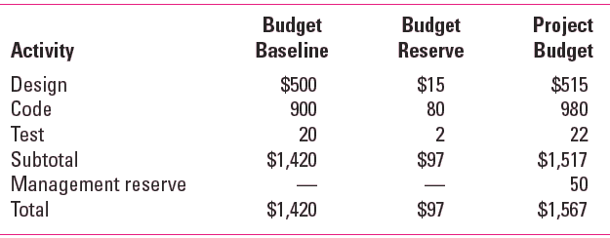
Contingency Fund Estimate (000s)
TABLE 7.1
Copyright © 2006 The McGraw-Hill Companies. All rights reserved.
McGraw-Hill/Irwin 7–<number>

Slide 19
Managing Risk (cont’d)
Step 4: Risk Response Control
  Risk control
    Execution of the risk response strategy
    Monitoring of triggering events
    Initiating contingency plans
    Watching for new risks
  Establishing a Change Management System
    Monitoring, tracking, and reporting risk
    Fostering an open organization environment
    Repeating risk identification/assessment exercises
    Assigning and documenting responsibility for managing risk
Copyright © 2006 The McGraw-Hill Companies. All rights reserved.
McGraw-Hill/Irwin 7–<number>

Slide 20

Change Management Control
Sources of Change
  Project scope changes
  Implementation of contingency plans
  Improvement changes
Copyright © 2006 The McGraw-Hill Companies. All rights reserved.
McGraw-Hill/Irwin 7–<number>

Slide 21
Change Management Control
The Change Control Process
  Identify proposed changes.
  List expected effects of proposed changes on schedule and budget.
  Review, evaluate, and approve or disapprove of changes formally.
  Negotiate and resolve conflicts of change, condition, and cost.
  Communicate changes to parties affected.
  Assign responsibility for implementing change.
  Adjust master schedule and budget.
  Track all changes that are to be implemented
Copyright © 2006 The McGraw-Hill Companies. All rights reserved.
McGraw-Hill/Irwin 7–<number>

Slide 22
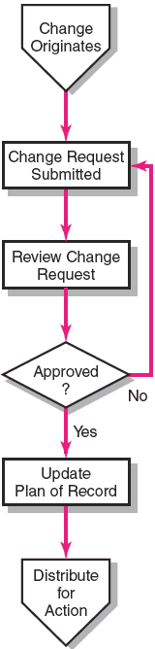
The Change Control Process
FIGURE 7.8
Copyright © 2006 The McGraw-Hill Companies. All rights reserved.
McGraw-Hill/Irwin 7–<number>

Slide 23
Benefits of a Change Control System
Inconsequential changes are discouraged by the formal process.
Costs of changes are maintained in a log.
Integrity of the WBS and performance measures is maintained.
Allocation and use of budget and management reserve funds are tracked.
Responsibility for implementation is clarified.
Effect of changes is visible to all parties involved.
Implementation of change is monitored.
Scope changes will be quickly reflected in baseline and performance measures.
Copyright © 2006 The McGraw-Hill Companies. All rights reserved.
McGraw-Hill/Irwin 7–<number>

Slide 24
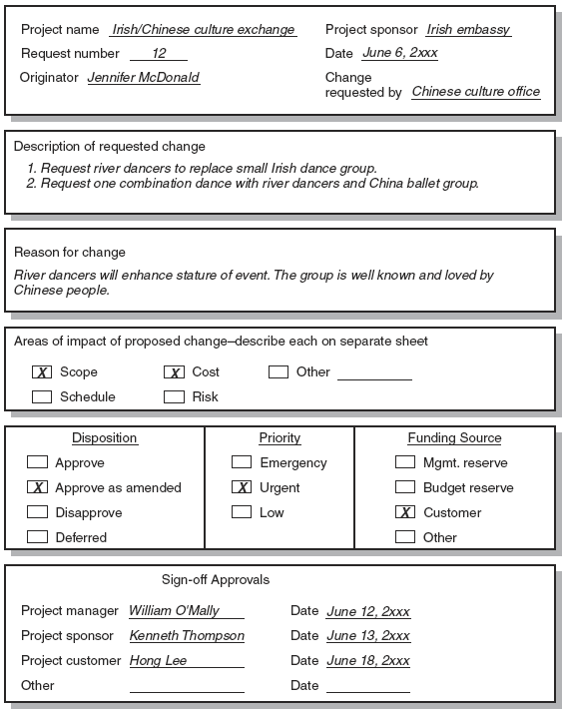
Change Request Form
FIGURE 7.9
Copyright © 2006 The McGraw-Hill Companies. All rights reserved.
McGraw-Hill/Irwin 7–<number>

Slide 25
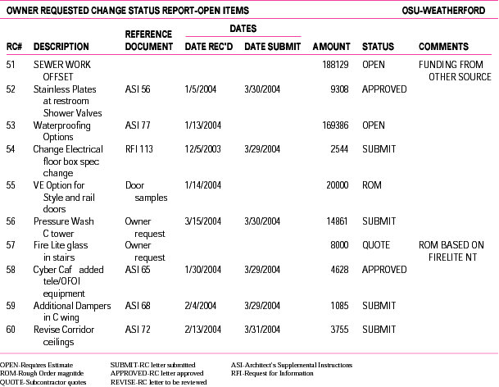
Change Request Log
FIGURE 7.10
Copyright © 2006 The McGraw-Hill Companies. All rights reserved.
McGraw-Hill/Irwin 7–<number>

Slide 26
Key Terms
Avoiding risk
Budget reserve
Change management system
Contingency plan
Management reserve
Mitigating risk
Risk
Risk profile
Risk severity matrix
Scenario analysis
Sharing risk
Time Buffer
Transferring risk
Copyright © 2006 The McGraw-Hill Companies. All rights reserved.
McGraw-Hill/Irwin 7–<number>

Slide 27
Chapter 7 Appendix
PERT and PERT Simulation

Slide 28
PERT—PROGRAM EVALUATION REVIEW TECHNIQUE
Assumes each activity duration has a range that statistically follows a beta distribution.
PERT uses three time estimates for each activity: optimistic, pessimistic, and a weighted average to represent activity durations.
  Knowing the weighted average and variances for each activity allows the project planner to compute the probability of meeting different project durations.
Copyright © 2006 The McGraw-Hill Companies. All rights reserved.
McGraw-Hill/Irwin 7–<number>

Slide 29
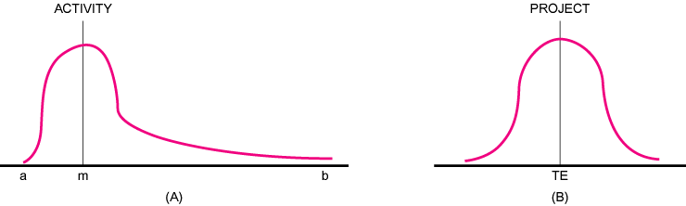
Activity and Project Frequency Distributions
FIGURE A7.1
Copyright © 2006 The McGraw-Hill Companies. All rights reserved.
McGraw-Hill/Irwin 7–<number>

Slide 30
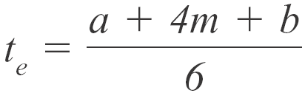
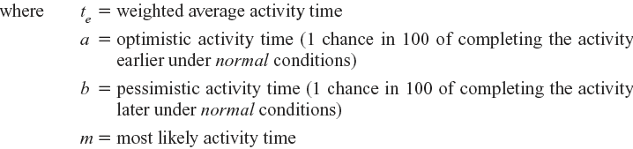
Activity Time Calculations
The weighted average activity time is computed by the following formula:
(7.1)
Copyright © 2006 The McGraw-Hill Companies. All rights reserved.
McGraw-Hill/Irwin 7–<number>

Slide 31
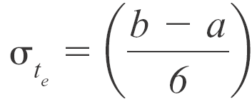

Activity Time Calculations (cont’d)
The variability in the activity time estimates is approximated by the following equations:
The standard deviation for the activity:
(7.2)
The standard deviation for the project:
(7.3)
Note the standard deviation of the activity is squared in this equation; this is also called variance. This sum includes only activities on the critical path(s) or path being reviewed.
Copyright © 2006 The McGraw-Hill Companies. All rights reserved.
McGraw-Hill/Irwin 7–<number>

Slide 32
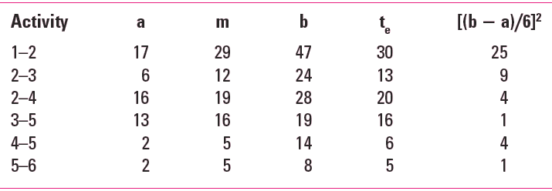
Activity Times and Variances
TABLE A7.1
Copyright © 2006 The McGraw-Hill Companies. All rights reserved.
McGraw-Hill/Irwin 7–<number>

Slide 33
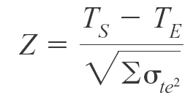

Probability of Completing the Project
The equation below is used to compute the “Z” value found in statistical tables (Z = number of standard deviations from the mean), which, in turn, tells the probability of completing the project in the time specified.
(7.4)
Copyright © 2006 The McGraw-Hill Companies. All rights reserved.
McGraw-Hill/Irwin 7–<number>

Slide 34
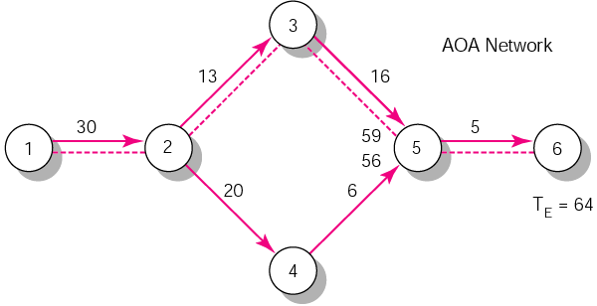
Hypothetical Network
FIGURE A7.2
Copyright © 2006 The McGraw-Hill Companies. All rights reserved.
McGraw-Hill/Irwin 7–<number>

Slide 35
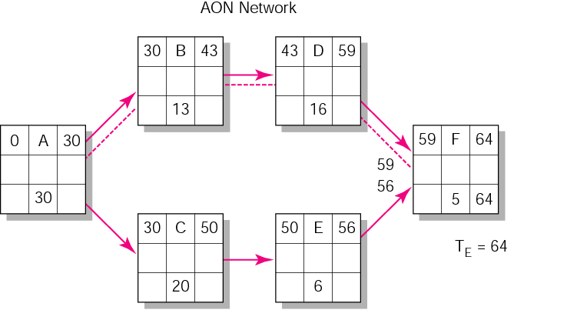
Hypothetical Network (cont’d)
FIGURE A7.2 (cont’d)
Copyright © 2006 The McGraw-Hill Companies. All rights reserved.
McGraw-Hill/Irwin 7–<number>

Slide 36
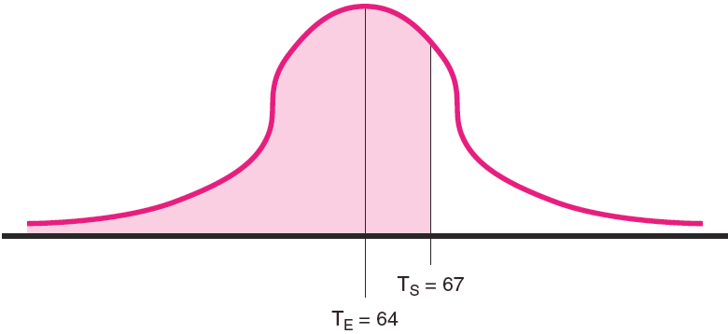
Possible Project Duration
FIGURE A7.3
Copyright © 2006 The McGraw-Hill Companies. All rights reserved.
McGraw-Hill/Irwin 7–<number>

Slide 37
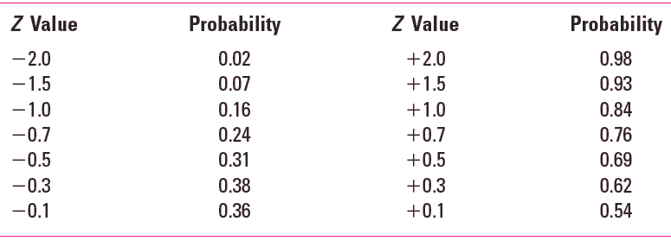
Z Values
TABLE A7.3
Copyright © 2006 The McGraw-Hill Companies. All rights reserved.
McGraw-Hill/Irwin 7–<number>

Slide 38
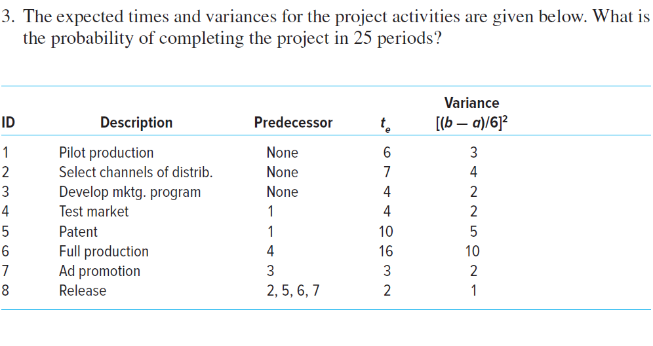
Copyright © 2006 The McGraw-Hill Companies. All rights reserved.
McGraw-Hill/Irwin 7–<number>

